Slide 1
Guns & Privacy
Hard Truths and Straight Talk
Coming From a Place of Love
Deviant Ollam

Slide 2
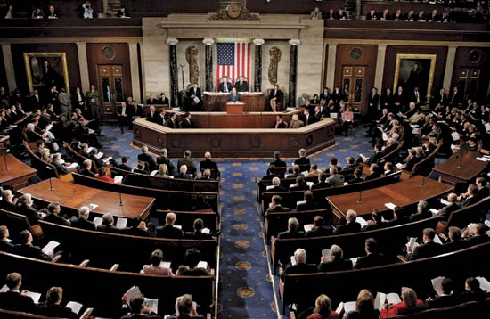
Recent Legislation

Slide 3
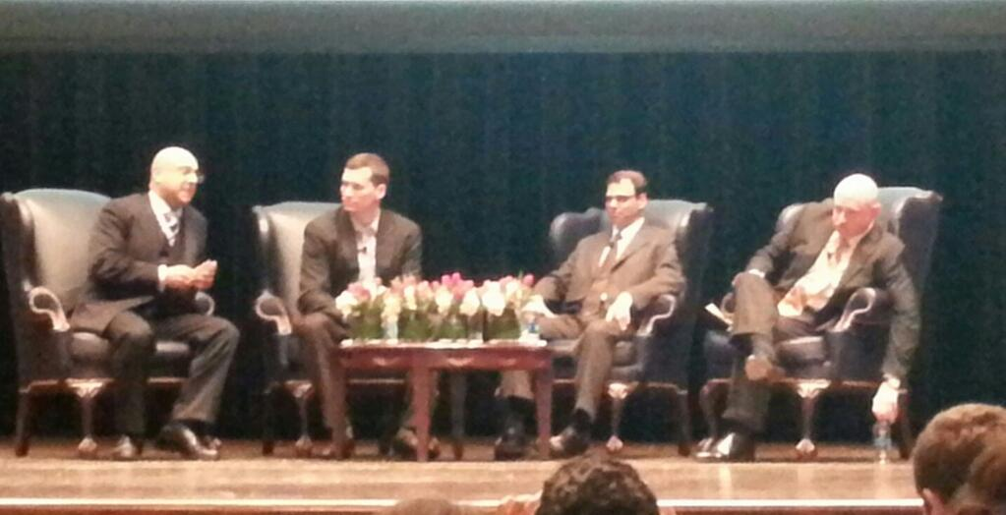
Recent Legislation

Slide 4
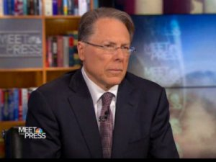
1. It Wasn’t Just the NRA Opposing This

Slide 5
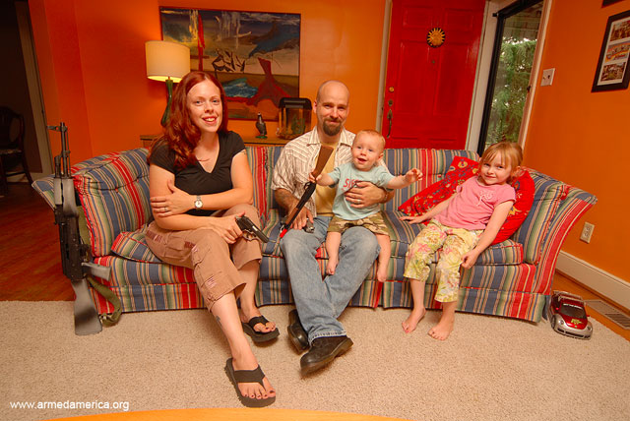
1. It Wasn’t Just the NRA Opposing This

Slide 6
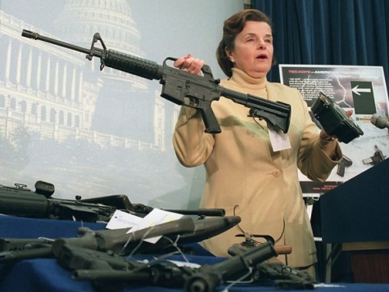
2. This Will Galvanize Gun Control Folk

Slide 7
2. This Will Galvanize Gun Control Folk

Slide 8
2. This Will Galvanize Gun Control Folk

Slide 9
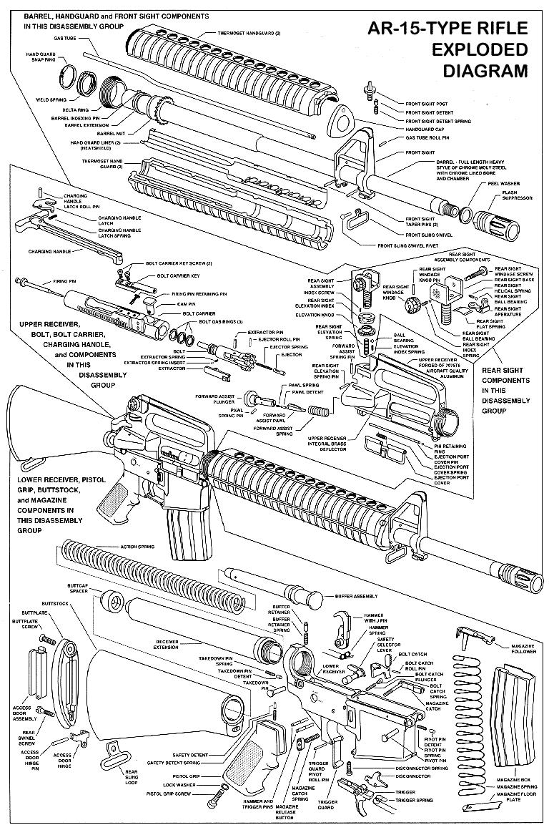
3. Gun Bans are Utter Poison

Slide 10
3. Gun Bans are Utter Poison

Slide 11
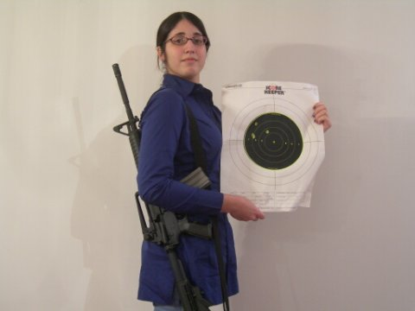
3. “Assault” Weapon Bans, Especially

Slide 12
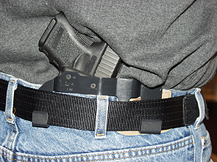
4. Amendments Will Ease Legislation
If you’re serious about stopping crime, get these people on your side!
\
with civil penalties!

Slide 13
5. Want Universal Background Checks?
Do you know the current system?

Slide 14
5. Want Universal Background Checks?
Web Based System
Totally Free
Accessible To Anyone
Buyer shows gov’t photo ID
Buyer also offers info not on ID (p.o.b.)
Kicks back instant Yea or Nay
No details of sale are part of that system

Slide 15
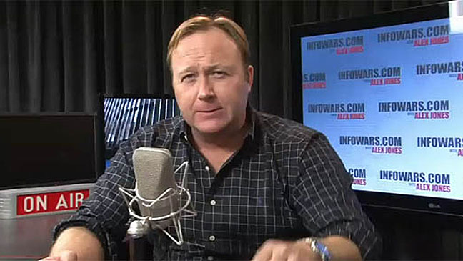
5. Want Universal Background Checks?
Important – law must specify that it applies only
to true transfers of ownership. 10/24 rule

Slide 16
6. Want to Actually Impact Gun Crime?
Toughen penalties for employing a gun in a premeditated manner
Toughen penalties for straw purchase
Buybacks are bullshit
Change the culture

Slide 17
7. Interesting Areas For Compromise
Waiting Periods
Capacity for Carry
Tackling the Mass-Straw-Purchase / Iron Pipeline Problem
hackers can help with this…

Slide 18
8. Where We Need Help and Innovation

Slide 19
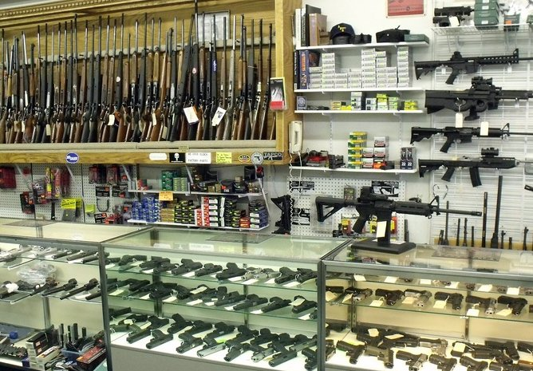
8. Where We Need Help and Innovation

Slide 20
9. Get Involved With OTHER VOICES
@GunCrisisNews @GunCrisisUS
@2AFDN @GunPolicy
Go to meetings & community events
Keep talking WITH one another…
…not AT one another

Slide 21
Thank You
deviant@deviating.net
@deviantollam
deviating.net/firearms

