Slide 1
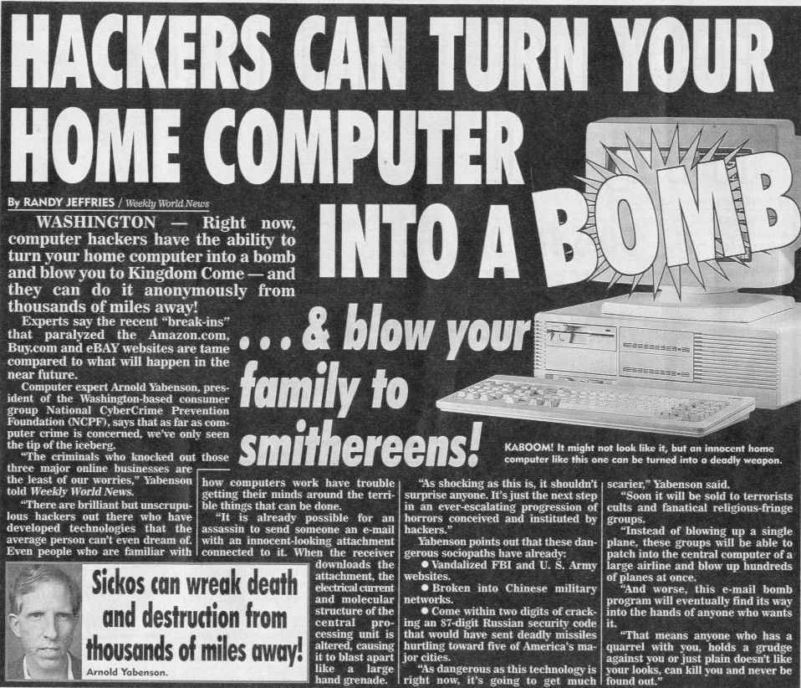
Notes:
Hello, intro, blah blah

Slide 2
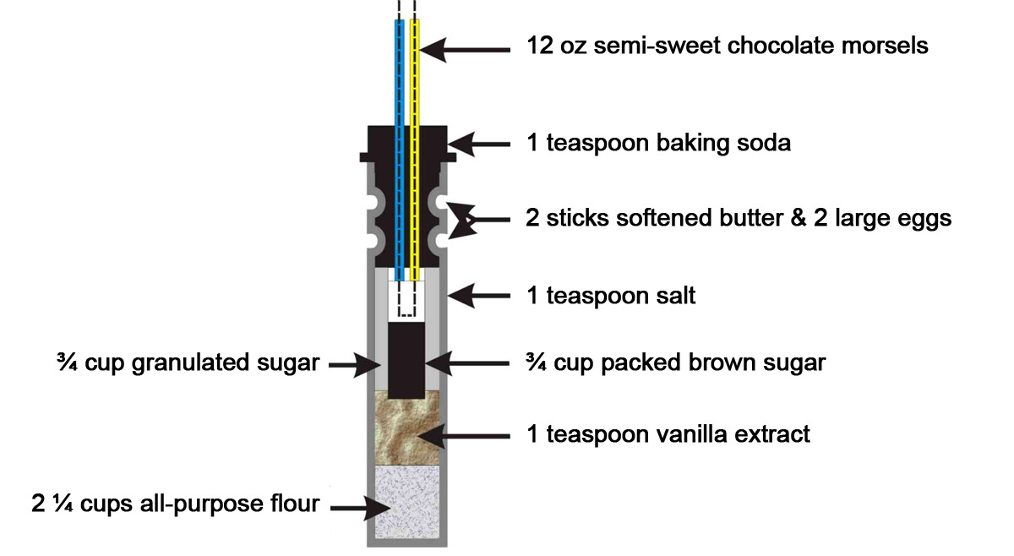
Notes:
I’m not going to reveal any specific instructions or chemical formulas to you folks

Slide 3
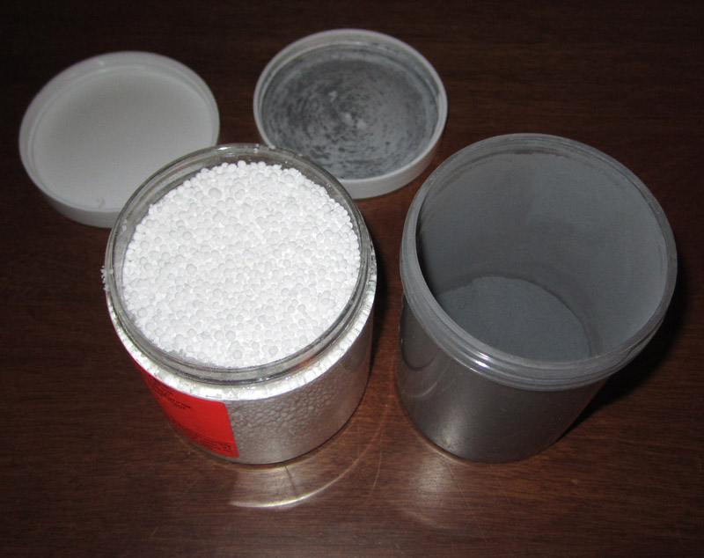
Notes:
There’s this stuff, you can buy it online

Slide 4
Notes:
You shoot it with a high-powered round

Slide 5
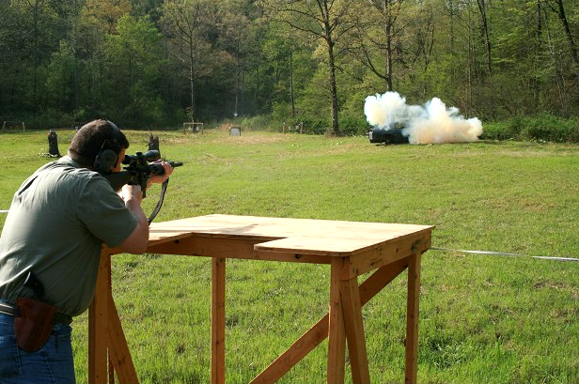
Notes:
It does this.

Slide 6
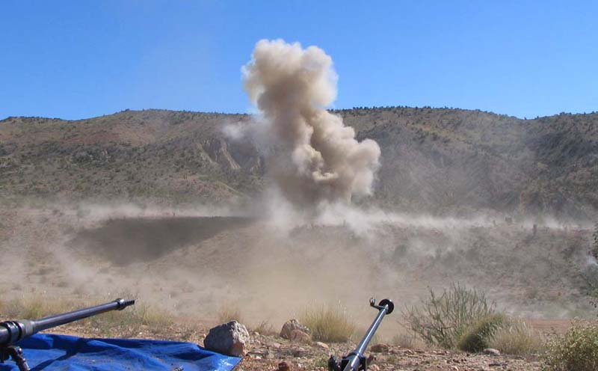
Notes:
It does it really well, the more you mix.

Slide 7
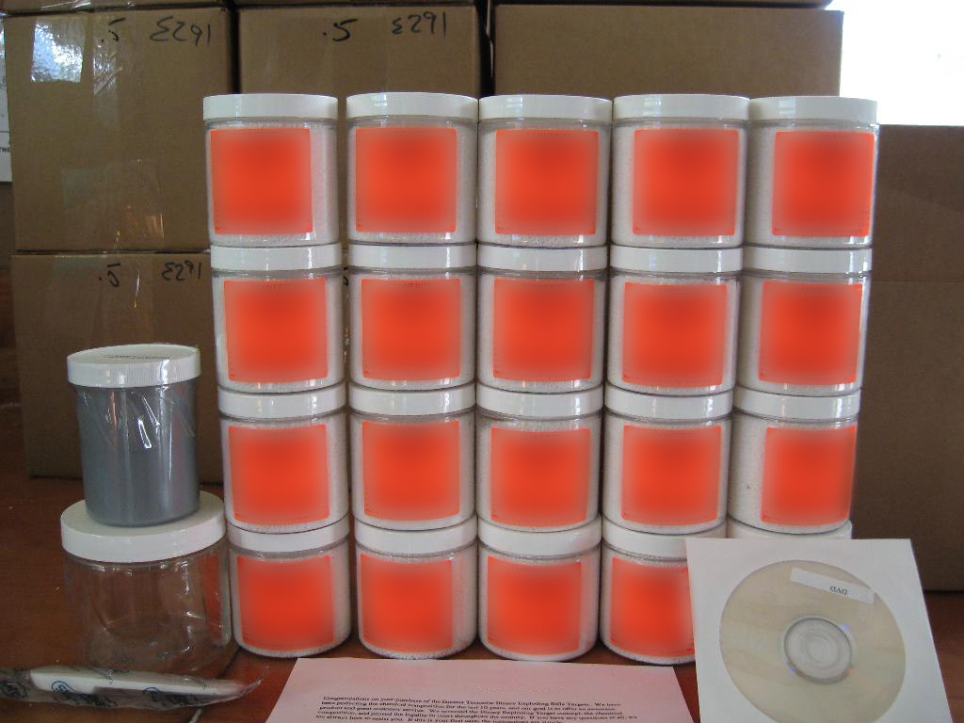
Notes:
Some people mix a whole fucking lot of it.

Slide 8
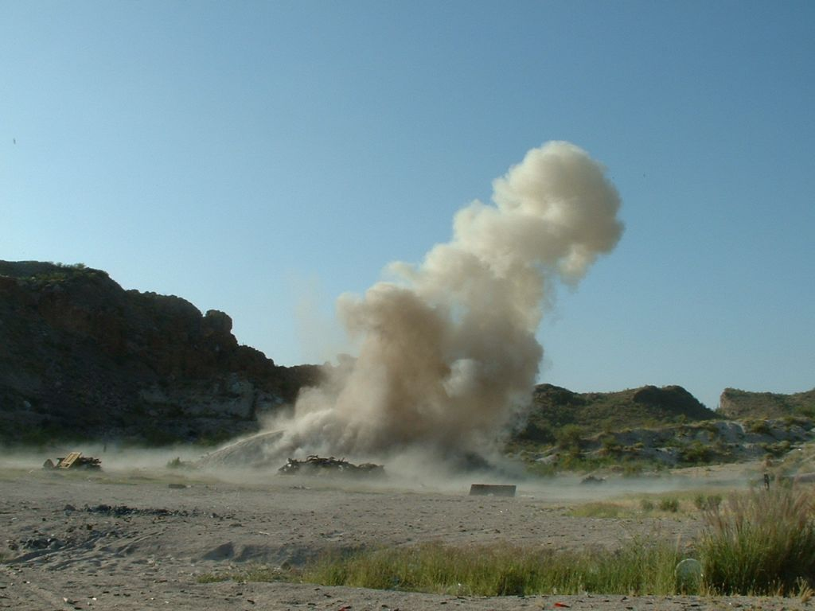
Notes:
Just to see what happens. Sometimes it makes the news.

Slide 9
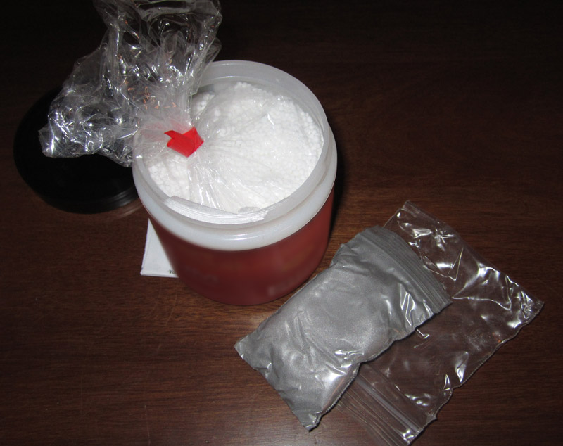
Notes:
There’s this other stuff. It looks like the first stuff, but it’s not. It’s different.

Slide 10
Notes:
Not only will this set it off…

Slide 11
Notes:
… but this will, too.

Slide 12
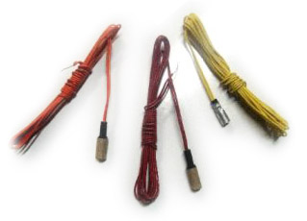
Notes:
A lot of things will set it off. Including some electronic items.

Slide 13
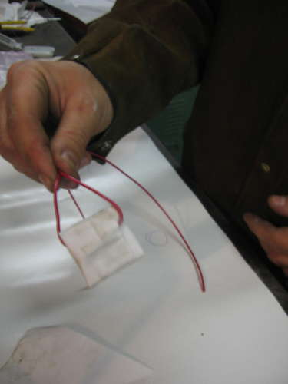
Notes:
They’re illegal, but there are instructables online regarding how to make them.

Slide 14
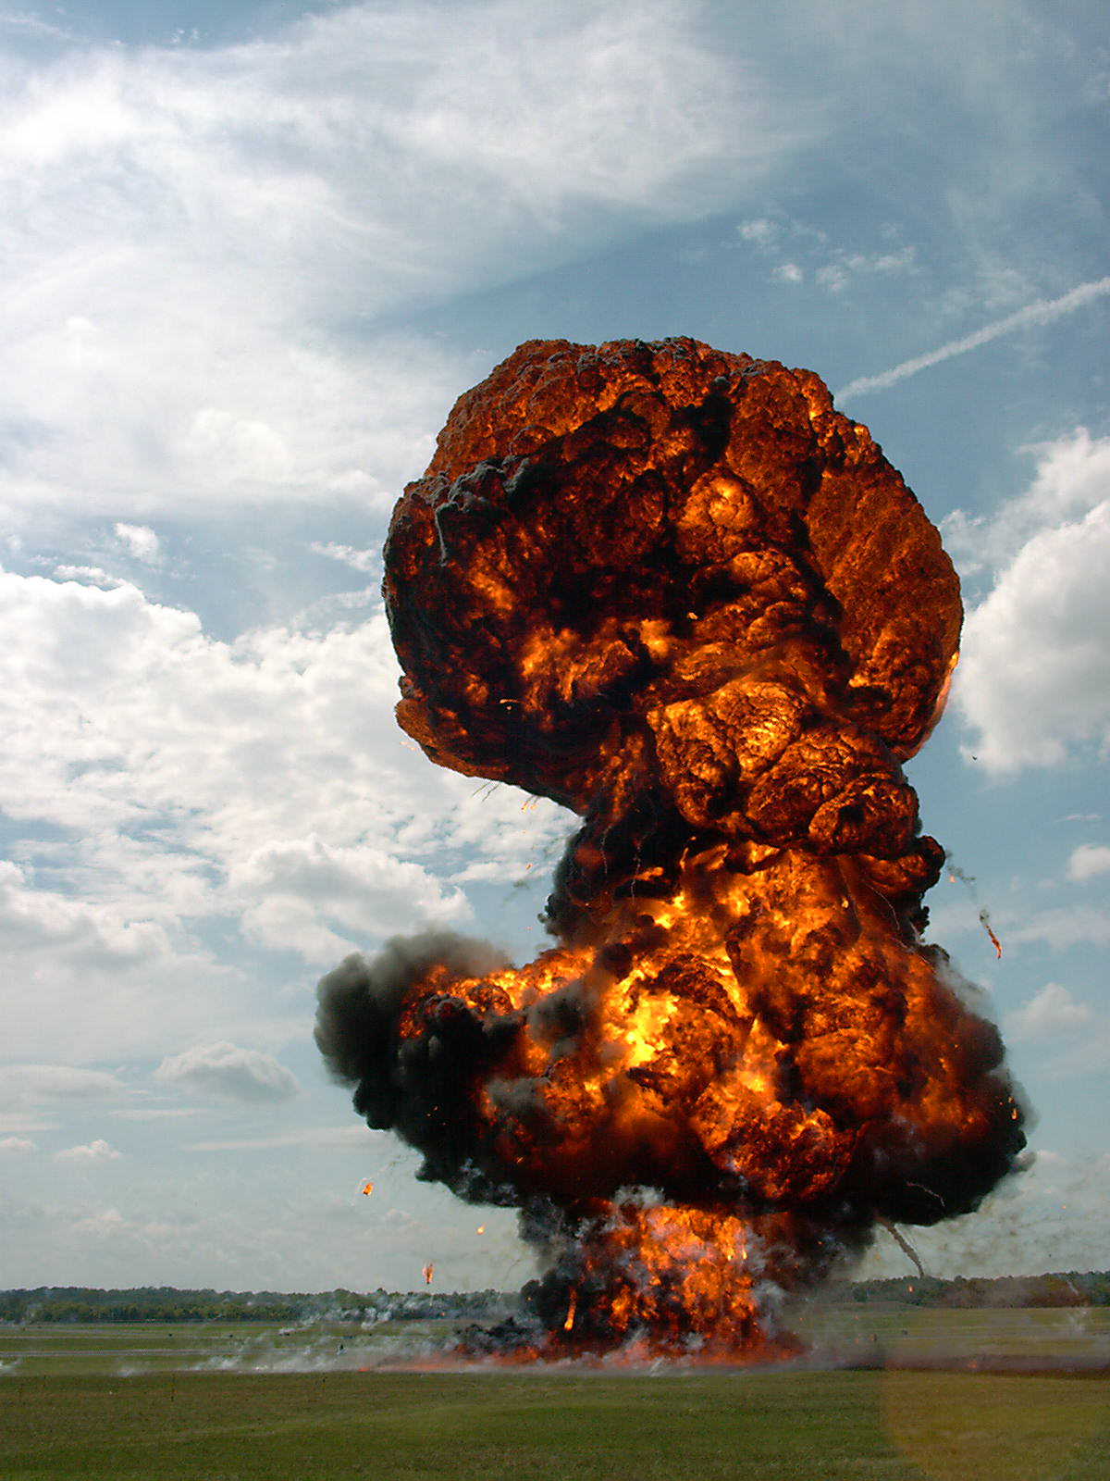
Notes:
One explosion initiates another explosion which blah blah blah on down the road to nowhere good.

Slide 15
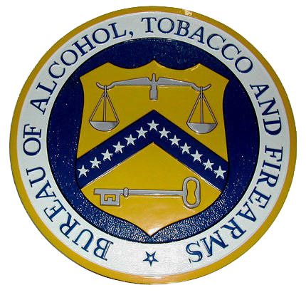
Notes:
If you do this, chances are some people will want to have a talk with you…

Slide 16
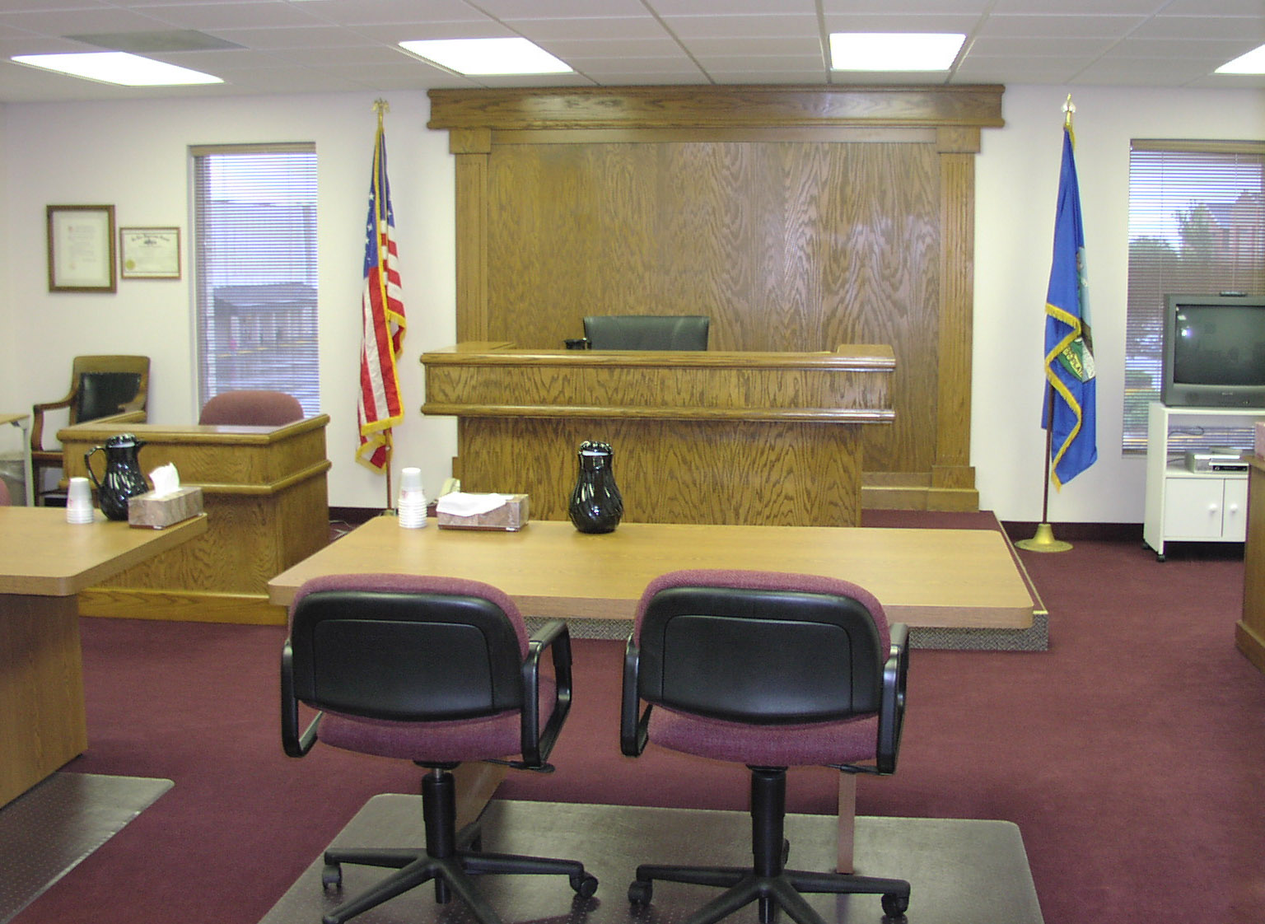
Notes:
… that conversation may take place somewhere that you don’t want to be

Slide 17
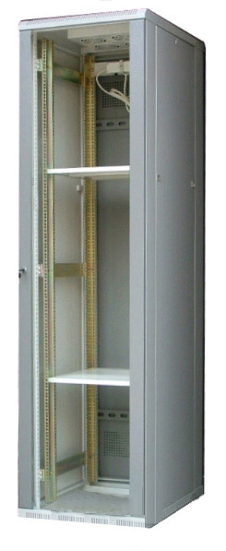
Notes:
The only real way to legally do this method of hard drive destruction would be…

Slide 18
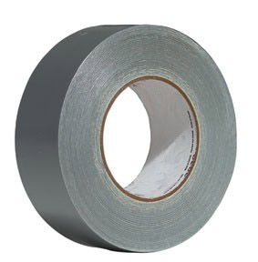
+
Notes:
To use duct tape…

Slide 19
+
+
Notes:
And attach a rifle directly to your server rack… with a live goddamn round it it, hammer cocked.

Slide 20
Notes:
You’d still be legal, since a live round is technically setting things off.

Slide 21
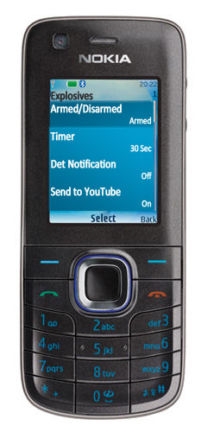
Notes:
… adding any sort of electronics to the detonation is a Bad Thing ™

Slide 22
Notes:
And those aforementioned people will almost certainly want to have a word with you…

Slide 23
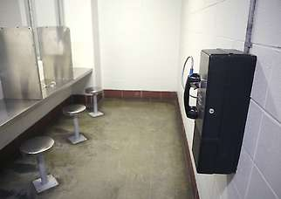
Notes:
… and it will almost certainly be a conversation taking place somewhere that you don’t want to be

Slide 24
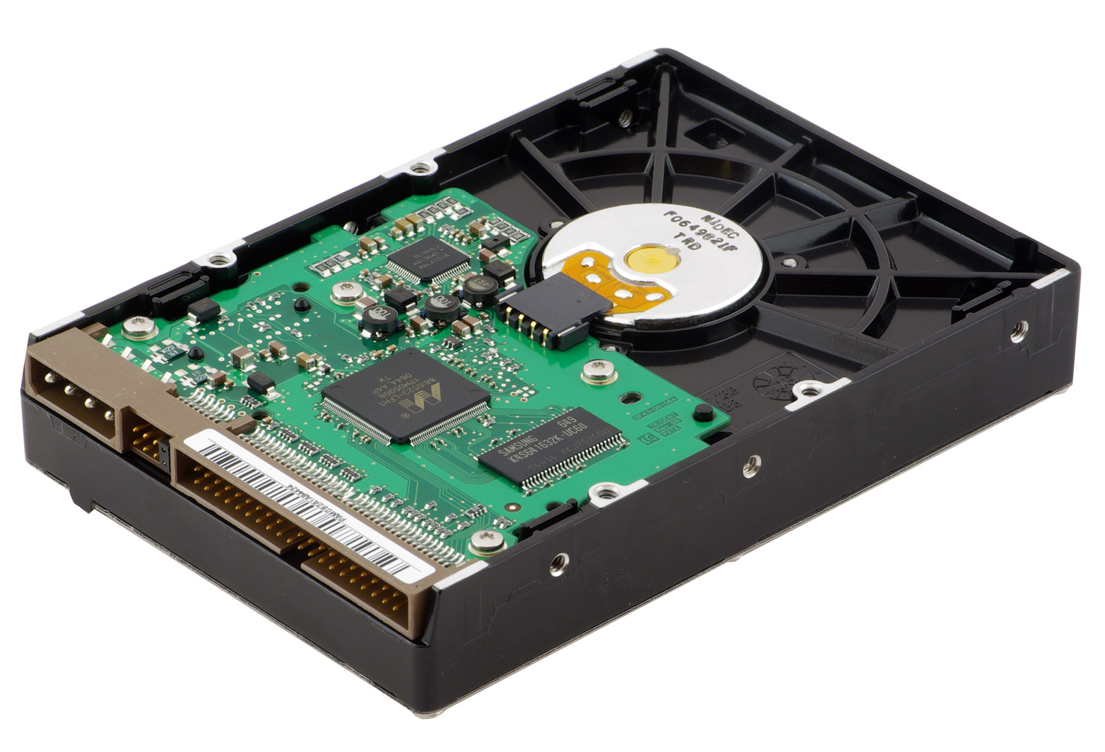
Notes:
We’ve all moved on from IDE hard drives…

Slide 25
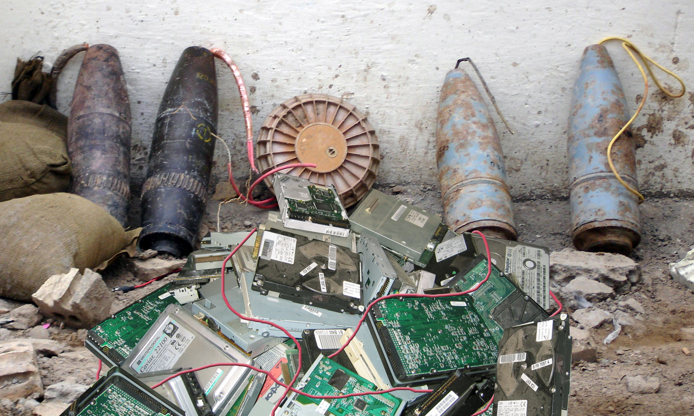
Notes:
… let’s not move toward IED hard drives

Slide 26
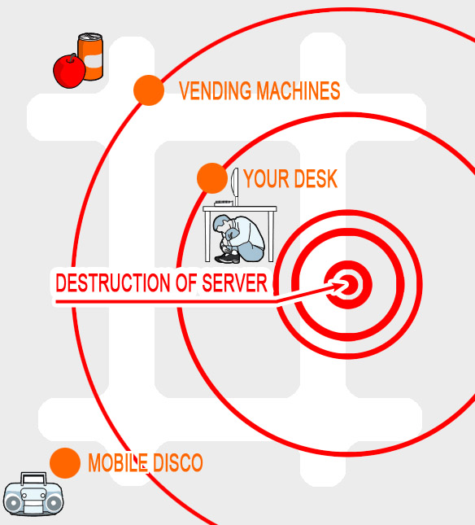
Notes:
Also, no matter how you set this up, there’s almost no way to properly destroy the hard drives without also poising serious risk to you, your office, etc. 23B are the only ones making it out alive in this diagram. (source: ready.gov)

Slide 27
Notes:
So, kids, what did we learn today?

Slide 28
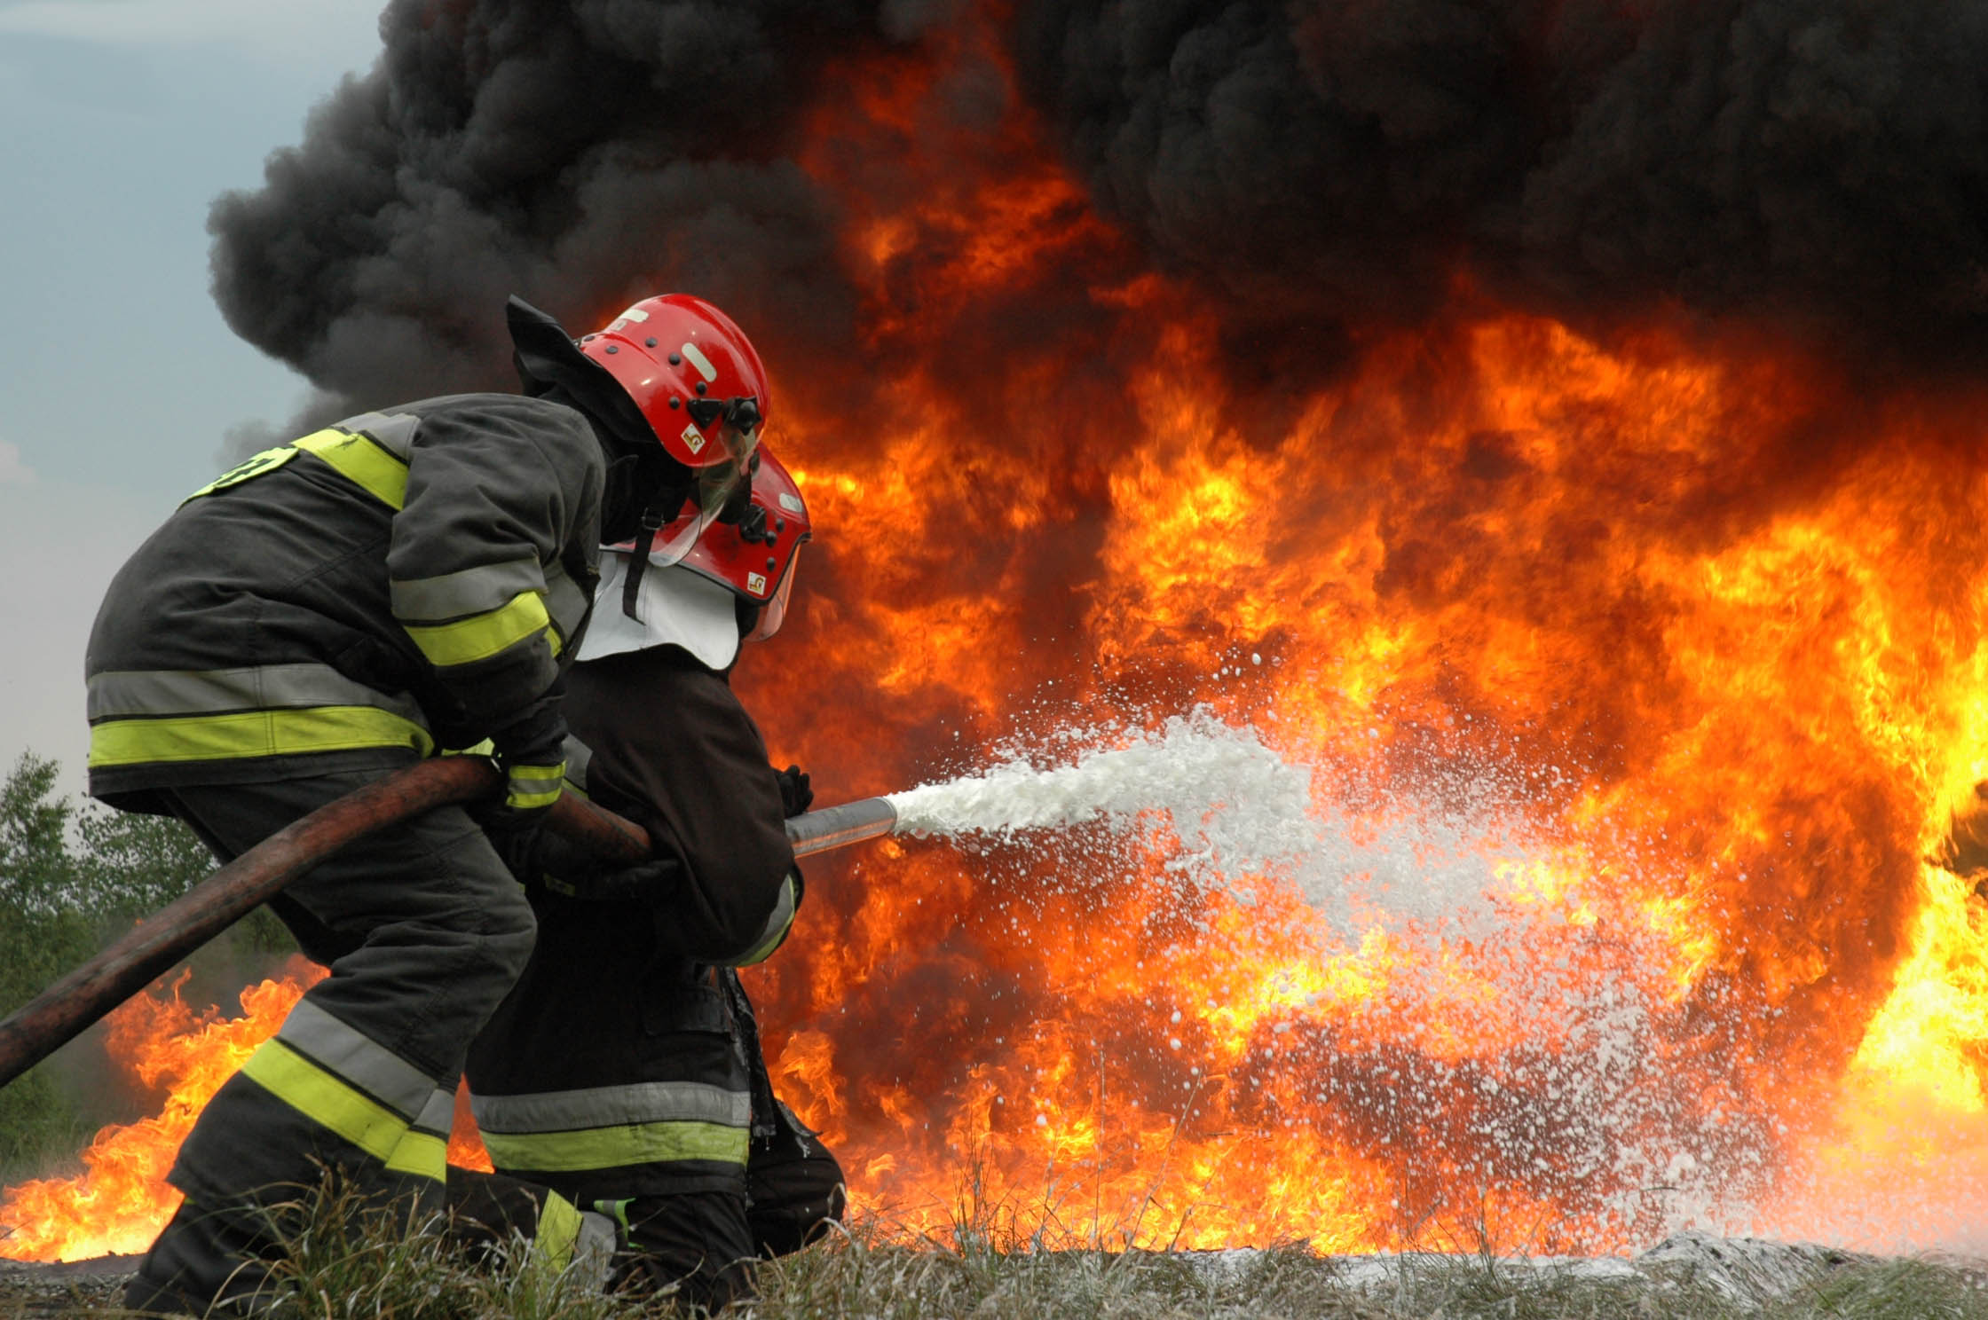
Notes:
Don’t do anything that will blow stuff up…

Slide 29
Notes:
… don’t do anything that will land you in the Emergency Room…

Slide 30
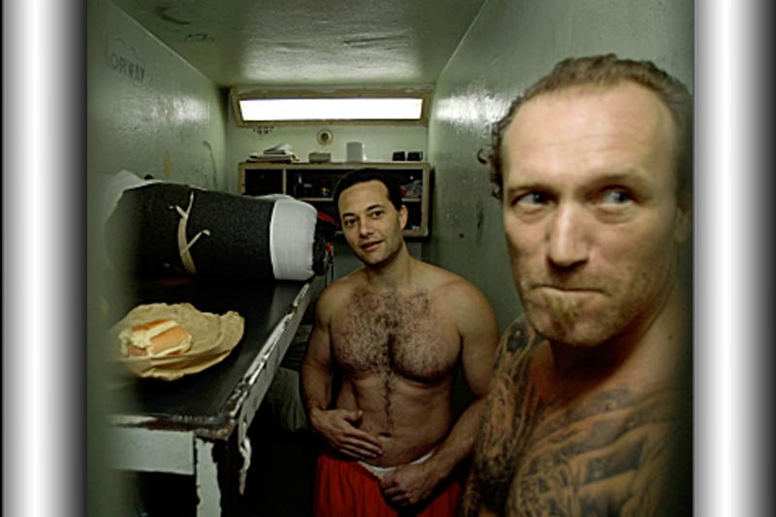
Notes:
… or worse, land you in prison

Slide 31
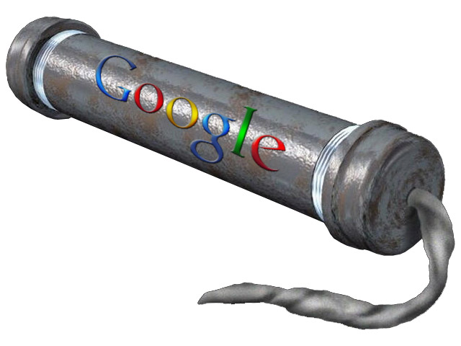
Notes:
If you REALLY feel the need to do stupid shit, you don’t need me to tell you things… plenty of info is out there elsewhere

Slide 32
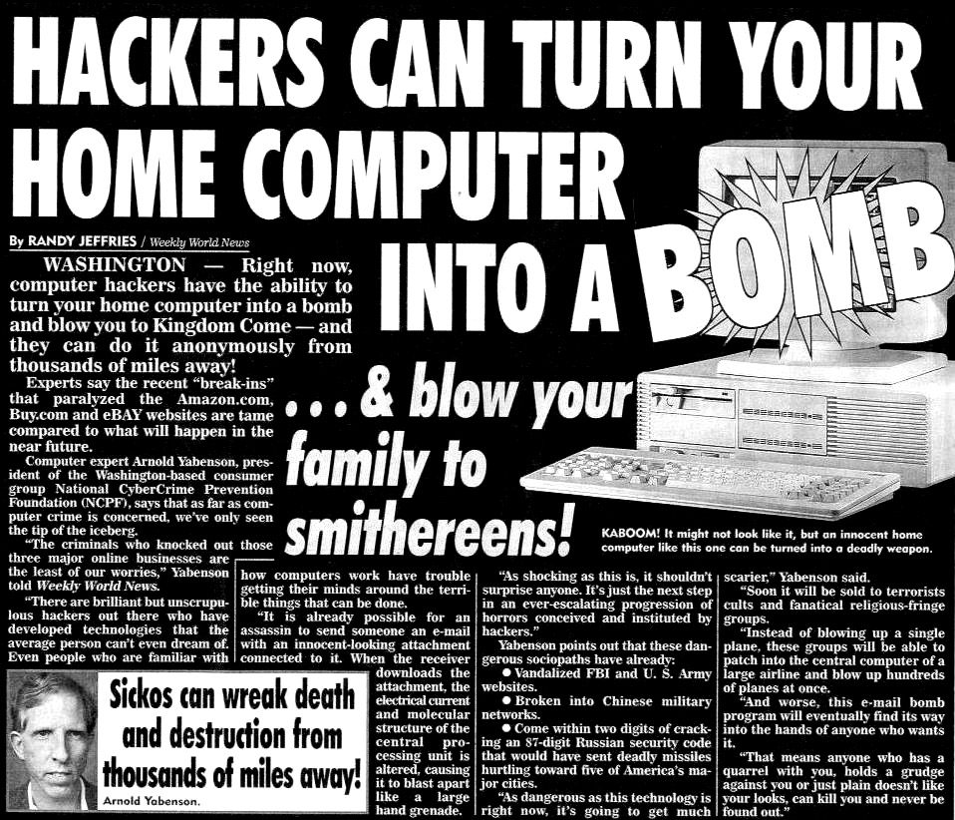
Notes:
Thank you blah blah

